Slide 1
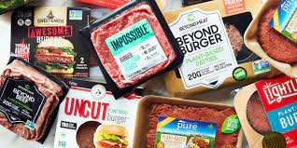
Where’s the Beef?
Tamar Brand-Perez, Tiffany Price, Ben Tubbs, and Jose Santos

Slide 2
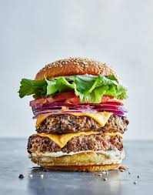
The Artificial Meat Industry
Security
Safety
Sustainability
$4.3 billion Industry
Notes:
Tiffany
Good evening everyone. Tonight we are going to answer the question of “Where’s the beef?”
Meat substitutes are emerging options for food security, food safety, and sustainability
Per Fortune Business Insights, the global population is projected to reach 9.8 billion in 2050; it is not feasible to sustain such an enormous population on animal meat alone.(https://www.fortunebusinessinsights.com/industry-reports/meat-substitutes-market-100239)
One of the most significant wake up calls is related to the pandemic. According to the NYT, farmers and ranchers who supply the nation with meat products were confronted with several crises at once: for example, during 2020, large processing plants shut down as workers fell ill as a result of COVID, and many producers were already strained by the trade war with China.
A larger concern is around global warming; the meat business has been under growing scrutiny in recent years for its climate change consequences, with scientists and environmentalists urging Americans to eat less meat. (https://www.nytimes.com/2020/04/17/climate/meat-industry-climate-impact.html)
The plant-based meat market was estimated to be valued at $4.3 billion in 2020. (https://www.marketsandmarkets.com/Market-Reports/plant-based-meat-market-44922705.html) And could be a $450 billion market by 2040. (https://www.bloomberg.com/news/articles/2021-04-16/beyond-meat-bynd-impossible-foods-battle-over-future-of-fake-meat-industry) OVERVIEW
The fake meat industry has recently experienced a dramatic shift in positive user sentiment. We wanted to explore this concept to ultimately provide stakeholders with the information and tools to assist them in determining which artificial meat brand to sell.
We feel passionately about the subject and hope that our efforts will aid in increasing the awareness and sales of artificial meat products.

Slide 3








Technology, Tools &
Language Used
Bag of Words Model
Machine Learning: Naive Bayes Classifier
Notes:
Tiffany
Technology used: Tableau & SQ Lite
Tools used: Git Hub, Flask, TablePlus
Language used: Python, sql, NLTK
Algorithms used: Bag of words model, Machine Learning: Naive Bayes Classifier
Now we will discuss Data Exploration & Analysis. Tamar will next spend the next few minutes sharing about our data gathering process and database.

Slide 4
Data

Slide 5
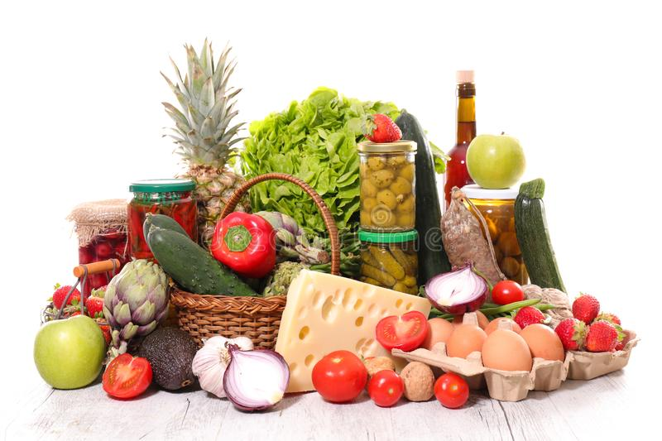
Data Source
Amazon product data
Metadata
Amazon scraped data
Reddit scraped data
Notes:
Amazon data to create ml model
Predict if review is positive or negative
Focus on fake meat
No brand product info
Add meta data
Merge did not work
scraped
Our initial goal was to use amazon reviews to create a machine learning model that accurately predicts whether a review is positive or negative.
Our goal was to focus on fake meat products but in the reviews dataset there was no brand and product information so we added the metadata dataset hoping to combine the two and find reviews specifically about fake meat.
That did not work so we added the scraped data.
We scraped reviews from amazon as well as reviews from reddit.

Slide 6
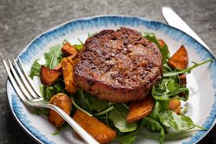
Alternatives to Meat
Notes:
Amazon and the reddit scraped reviews were specifically of fake meat products.
We scraped data from amazon to add the brand product price information
We focused specifically on fake meat products.
The reddit reviews did not have star ratings. We scraped the reddit reviews about fake meat to show that our machine learning model could predict if a review is positive or negative therefore expanding the number of reviews that store owners could use to help them in understanding how people feel about different fake meat products and ultimately, help them decide which brands and products they may want to sell in their stores.

Slide 7

Data content
Source | Amount | Star rating | Review Text | Reviewer | Date | Brand | Product | Price | asin | len
UCSD Amazon | > 1 million
UCSD metadata | 116
Scraped Amazon | 1073
Scraped Reddit | 19
Notes:
Overview of data content:
Groceries dataset had text and star rating
No brand and product
Metadata was supposed to be the same dataset
Tried to merge concatinate join inner outer on asin
Didnt work
Asin were different
Scraped amazon had everything
Reddit data we used to demonstrate that with only the review text we can determine if a review is positive or negative
Help expand information about fake meat products
This table shows an overview of the data available in each of the datasets we used:
General groceries dataset from ucsd had more than 5 million reviews. After cleaning the data we had more than 1 million reviews. This data included star rating and review text among other pieces of information but it did not have brand and product data.
The metadata that was supposed to belong to this groceries dataset did have brand and product information but there were only 116 reviews about fake meat and the only common column was the asin column for these two datasets.
when we combined the metadata about fake meat with the original reviews dataset, we were left with 12 rows of data. We found out that it was due to the asin numbers not matching. After multiple attempts at merging joining, and concatinating the data with no significant success we decided to shift to scraping reviews with product and brand information.
Scraped data was specifically about fake meat products. when scraping we had to input each url separately to get the data.
Lastly, the reddit data we scraped only the review text and using our machine learning model we were able to predict whether the review of fake meat on reddit was positive or negative.

Slide 8

Data Cleaning
Dropped columns
Added length column
Dropped duplicates
1 and 5 stars
Trimmed the 5 stars
Notes:
Dropped columns that were not relevant
Added number of words column
Dropped duplicates
Kept only the 1 and 5 star ratings
Trimmed 5 star
We dropped columns that were not relevant for our goal:( columns that were dropped were: verified, reviewer name, summary of the review text, unix review time,( vote, image and style - had little data in them))
We decided we wanted to know if there was a connection between the length of the review and the rating so we created another column that counted the number of words in each review. That was the review length column.
Dropped duplicate rows that is rows that all data was identical were dropped.
Narrowed the data to include only the 1 and 5 starred reviews so the difference between the positive and negative was more obvious.
Trimmed the 5 star reviews from more than 3 million reviews to 600,000 to match the number of reviews we had for 1 star so the training and testing is balanced

Slide 9
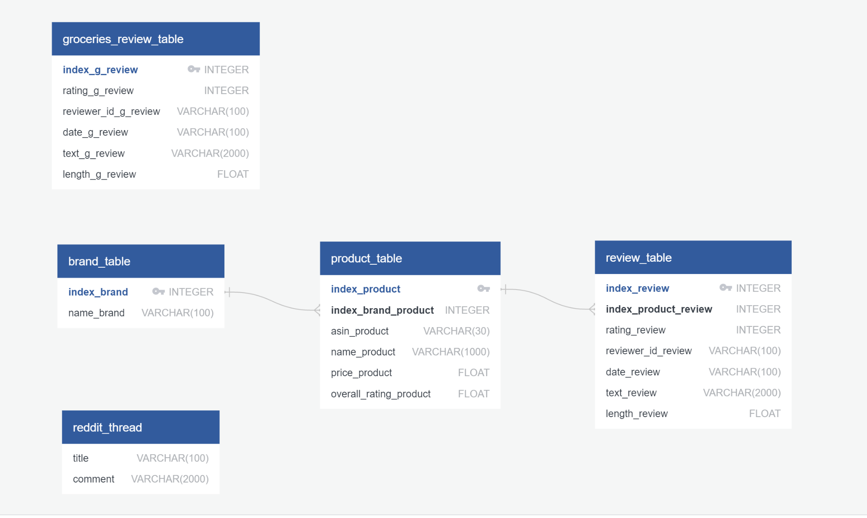
Database
Notes:
Sqlite and sqlalchemy to create database
Used python and table plus to interact with the database
This erd is showing the tables:
Groceries, three scraped amazon tables and reddit table.
Database
We used Sqlite and sqlalchemy to create the database. This was a local database that is suitable for the development stage of a project.
We interacted with the database using python, and table plus.
This ERD is showing the tables in the database. The first one is the data from amazon general groceries. (I did not include the metadata because we did not use it.) The three in the middle are from the amazon scraped data. The first one is of the brands. The second is the products. Since each brand has several products, the connection is one to many. Since each product has multiple reviews the connection between the product and the review table was also one to many. Lastly we have the reddit table.

Slide 10
Questions
How do people feel about fake meat products
Positive or negative review?
Frequent words reviewers associate with a brand.
Price change over time?
Rating change over time?
Inform grocery store owners
Notes:
How do people feel about fake meat - one big
Questions the team hopes to answer with this data:
Inform store owners about fake-meat products so they can make decisions whether they want to have these products in their store.
Did a fakemeat product receive a positive or negative review?
What are some keywords that users use frequently when giving positive or negative reviews.
Did the price of these fakemeat product change over time?
Did the rating of these products change over time?

Slide 11
Machine Learning
Notes:
We are creating a sentiment analyzer that classifies reviews as positive or negative.
Our dataset is a collection of Amazon reviews that we used to train the model. Amazon reviews may contain any type of lexicon including words that are misspelled, abbreviated, capitalized, contain punctuation, etc. The first step is to normalize this lexicon so that items such as “I’m”, “Im”, “i’m” and “im” are not treated as different words.

Slide 12
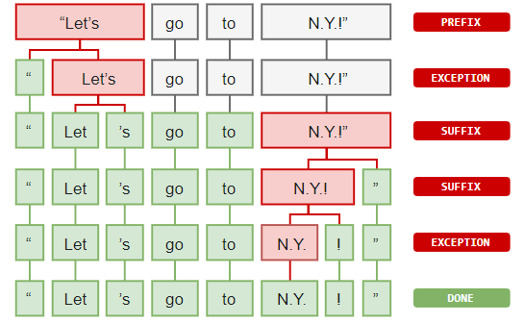
Preprocessing and Normalization
Tokenization
Casing
Removing Non Alphanumerics
Length
Stop Words
Lemmatization
Notes:
We need to split the sentence into a list of words for processing. We could do something simple like split the sentence at each word space. Tokenizers split words in an intelligent way, so that words with periods, such as “Mr.” are not treated as separate tokens.
Normalization
Casing - The first step was to switch every letter of every token to lowercase, so that tokens such as “The” and “the” would not be treated as separate entries
Removing Non Alphanumerics - Next all letters that were not alphanumeric were removed to prevent words such as “mr” and “mr.” from being treated as separate tokens
Length - All tokens that were less than length 2 were also removed
Stop Words - Stop words were removed
Lemmatization - All words were lemmatized for greater normalization

Slide 13
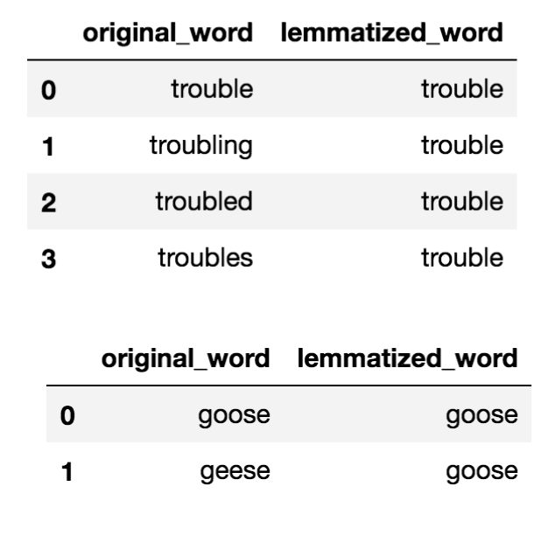
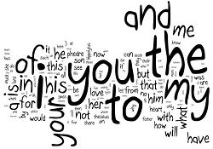
Cleaning
Notes:
Stop words are words that do not add a lot of meaning to the text such as “the”, “it”, “as” and “about”. Stop words were removed.
The same word may come in many forms, such as: “eat”, “ate”, “eaten”, etc. All of these words can be normalized to what are called lemmas so that they are not treated as separate tokens, but as the same token.

Slide 14
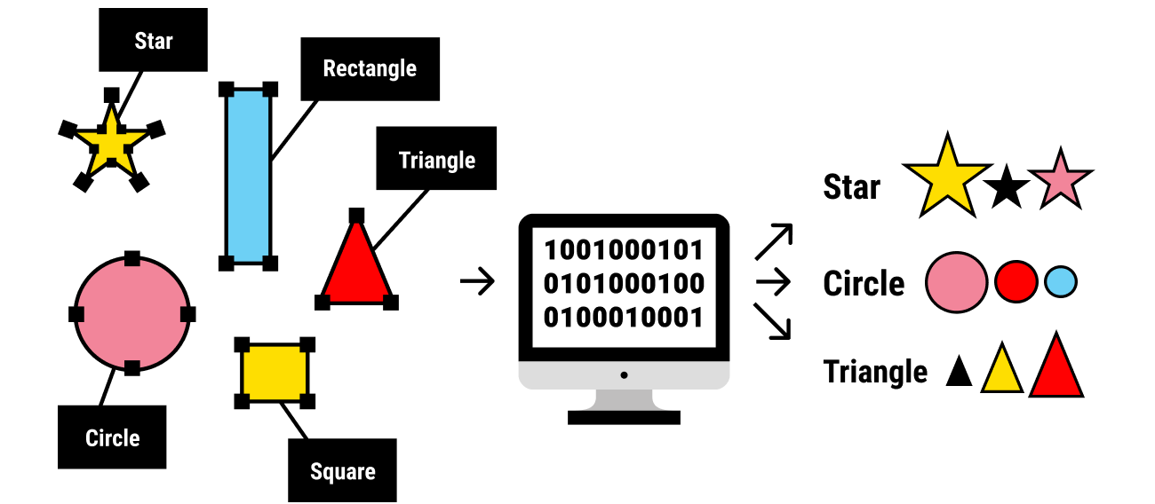
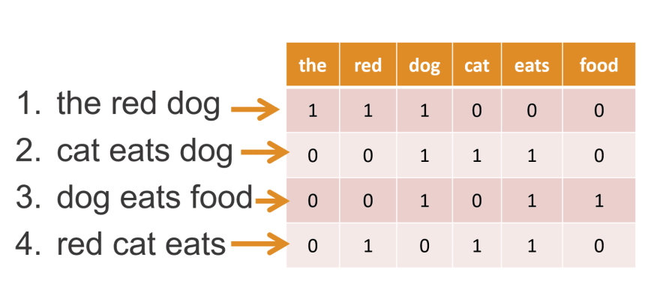
Feature Set
Notes:
Next, we need to create the labeled data. We used only the five star reviews as positive and the one star as negative. There were many more positive than negative reviews, so we used only 1000 of each to eliminate bias in the model. We used monograms which means each word is treated separately and word order is not taken into account. We then turned each review into a vector (a python dictionary) of the 3000 most common words in all of the reviews. This dictionary stores the presence or absence of each of the 3000 most common words in all of the reviews.

Slide 15
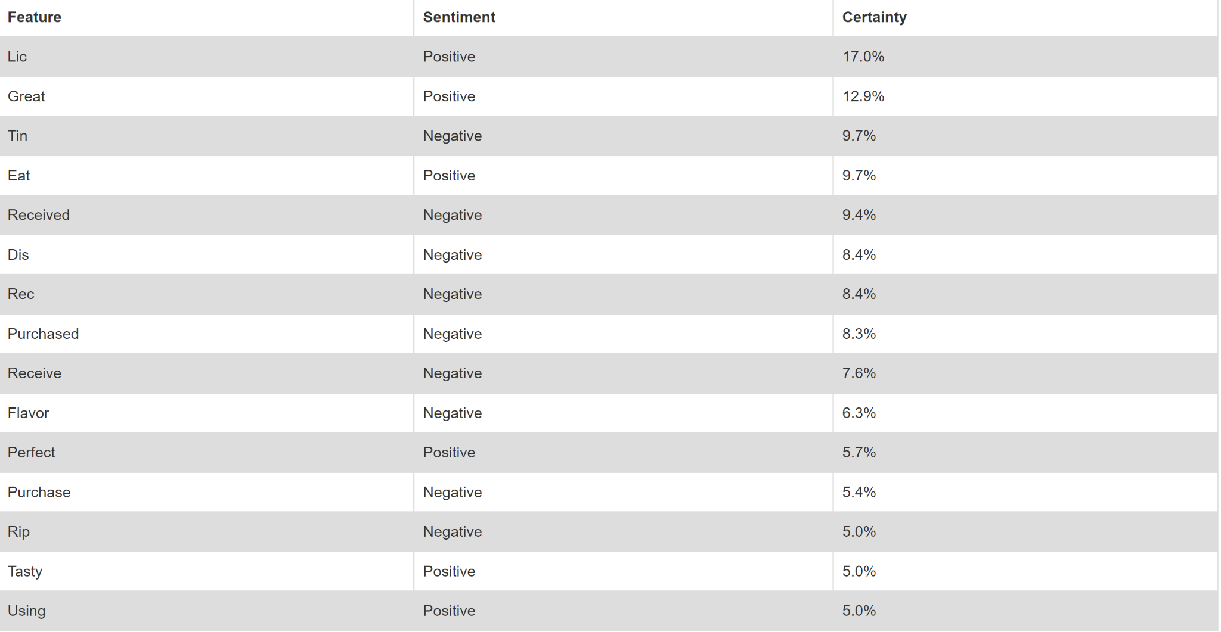
Most Informative Features
Notes:
Here are the top fifteen most informative features along with whether they are positive or negative and the percentage of how telling they are.

Slide 16
Visualizations
Notes:
Tiffany - introduction
To create visualizations in Tableau, we scraped amazon for reviews and ratings of 5 fake meat brands. Using over 1,000 reviews we were able to analyze various aspects of the data. Jose will explain in detail.

Slide 17
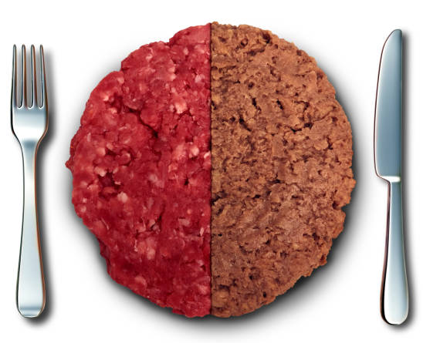
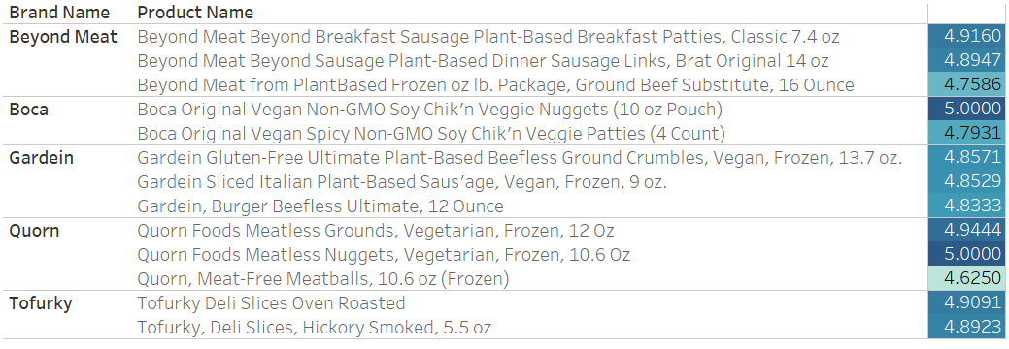




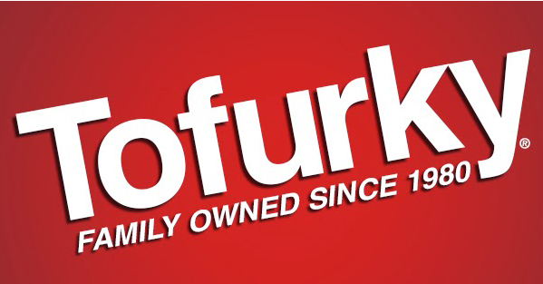
Fake Meat Products Reviewed
Notes:
An average of 3 products per brand were included in the analysis.
Rating on right is colored per brand.
RATINGS ARE INCORRECT - NEED TO RECALCULATE FROM FULL DATASET

Slide 18
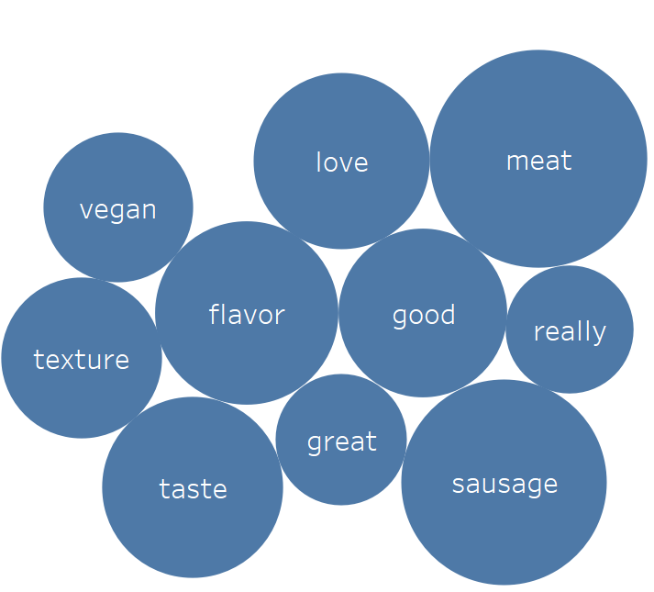
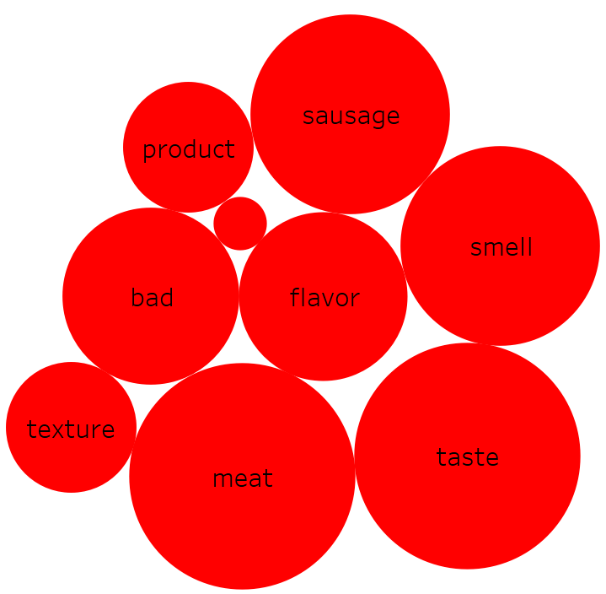
Fake Meat Brand Sentiment
Vegan, love, good, really, great
Product, bad, smell
Notes:
Two word clouds to show the 10 most frequent words used in positive (blue circles) and negative reviews (red circles).
Area of circle is proportional to the frequency that the word appeared in the reviews (normalized per sentiment).
Stars indicate words that are only used in one sentiment review (positive or negative).
This view allows a stakeholder to associate keywords that define a brand with positive and negative reviews. By doing so, the store owner is afforded a comparison between positive and negative “traits” per brand (as shown here) or positive/negative traits for a brand comparison.
Starred words indicate words with high frequency in a sentiment review and that do not show up in high frequency on the opposite sentiment review.
Process:
Created word cloud by taking text of reviews in csv format - 1000 total reviews (200 per brand, 40 by product per brand) - note that there were 870 positive reviews and only 130 negative reviews - and converting text to columns.
Then filtered out CSV file to only contain 1) reviews with ratings of 1 or 2 (negative reviews) and 2) reviews with ratings of 4 or 5 (positive reviews) to create two new CSV files.
Next each csv file was saved as unicode text and imported as a data source into tableau.
Stop words were filtered out using a list of words taken from: http://xpo6.com/list-of-english-stop-words/
Then a filter was applied to only show the top 10 most frequent words for each brand.

Slide 19
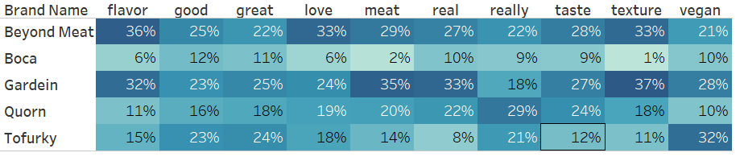
Keyword frequency by brand in positive reviews
Notes:
Info on how often a keyword (top 10 from all reviews) is used in a review of a product of a brand - brand to brand comparison. E.g. out of total number of times that “flavor” was used in positive reviews for all brands (100%), 36% of those instances were found in reviews of Beyond meat products.
This view allows the store owner to perceive how each reviewer associates a keyword in a POSITIVE review with a certain brand.
The bordered cells indicate the brand for which that particular word was used with the highest frequency.
Cells are colored from light blue (low frequency) to dark blue (high frequency) according to percent observed down a column.

Slide 20
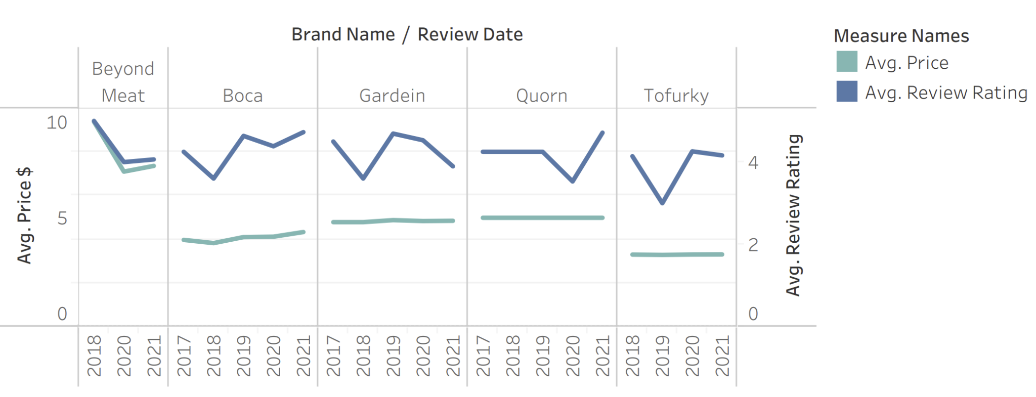
Review v. Price by Brand per Year

Slide 21
Summary
Results
ML model accuracy is 82%
Stakeholders’ prediction of customer sentiment
Specific words and brand association
Limitations
Rushed time frame
Limited initial data set
Algorithm does not consider the order of words
Notes:
Tiffany
RESULTS
In conclusion, our hope is to facilitate increased sales of artificial meat products by way of empowering store owners in their decision making process of which products/brands to sell.
Our ML model predicts the sentiment of user entered reviews with approximately 82% accuracy. We have seen a range of 80-84% depending on which data is used to train the model.
Also, through use of our interactive website, stakeholders have the ability to understand customer sentiment upon testing reviews.
Finally, from the word clouds and the table analysis of the reviews, the stakeholder will be able to associate specific product description words with the respective brand. This allows for a deeper understanding of how customers choose to comment about a specific product and brand.
LIMITATIONS
· Our time frame was rushed; as were learning about the limitations of our data set, we were already using it
·
Since our initial data set was limited, we were not
necessarily focused on the best data set available. We operated with what we had and made the
most of it due to time and resource constraints, including but not limited to,
computer capacity and also eventually being blocked by Amazon during our web
scraping.
·
Finally, the algorithm does not consider the order
of words (ie food tastes great v great tasting food)

Slide 22
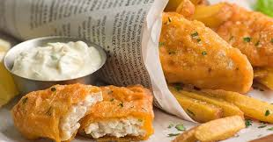
Future Analysis
Interactive visualizations
Larger data set
Location data
Ways to Improve Project
Search for a more accurate algorithm
Have algorithm consider word order
Host website on server
Notes:
Tiffany
FURTHER ANALYSIS
If we were to continue future analysis, we would:
· Include more interactive visualizations for the end user
·
Scrape in a larger data set, as available
·
Pull in location data of reviews to further enable
stakeholders’ insight into consumer sentiment by location. This would allow for
more market focused guidance.
WAYS TO IMPROVE PROJECT
· We would search for a more accurate algorithm
·
We would have our algorithm consider word order
·
Finally, we would host our website on a server
Thank you and now Ben will present our website and the informative interactive features.

Slide 23
Interactive Website Demo

Slide 24
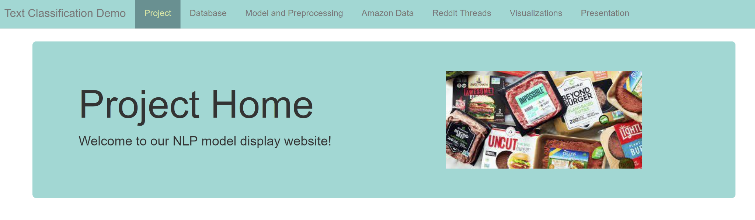
Interactive Dashboard
Notes:
Ben
Explanation of website/dashboard and interactivity features to predict if a review will be classified as a positive or negative review.

Slide 25
Sentiment specific keywords
 | KEYWORDS | KEYWORDS
 | Vegan, love, good, really, great | Product, bad, smell
 | Vegan, love, good, really, great, meat | Bad
 | Vegan, love, good, really, great, texture, sausage, flavor | Bad
 | Vegan, love, good, really, great | Bad, product, food
 | Vegan, love, good, really, great, taste, meat | Bad, smell, food
Notes:
Sentiment specific keywords taken from word cloud - words that show up with high frequency in a sentiment review but do not show up on the opposite sentiment review.

Slide 26
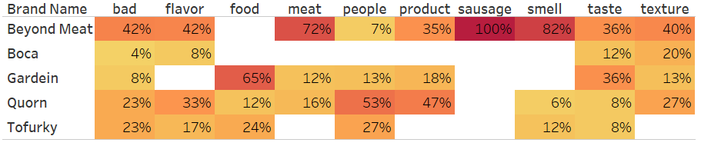
Keyword frequency by brand in negative reviews
Notes:
Info on how often a keyword (top 10 from all reviews) is used in a review of a product of a brand - brand to brand comparison. E.g. out of total number of times that “flavor” was used in positive reviews for all brands (100%), 36% of those instances were found in reviews of Beyond meat products.
This view allows the store owner to perceive how each reviewer associates a keyword in a NEGATIVE review with a certain brand.
The bordered cells indicate the brand for which that particular word was used with the highest frequency.
Cells are colored from light yellow (low frequency) to dark red (high frequency) according to percent observed down a column.

Slide 27
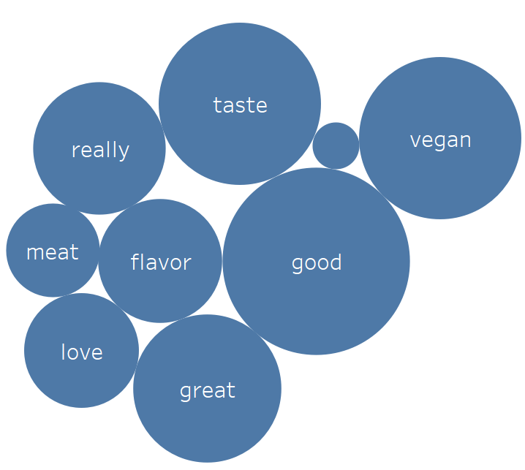
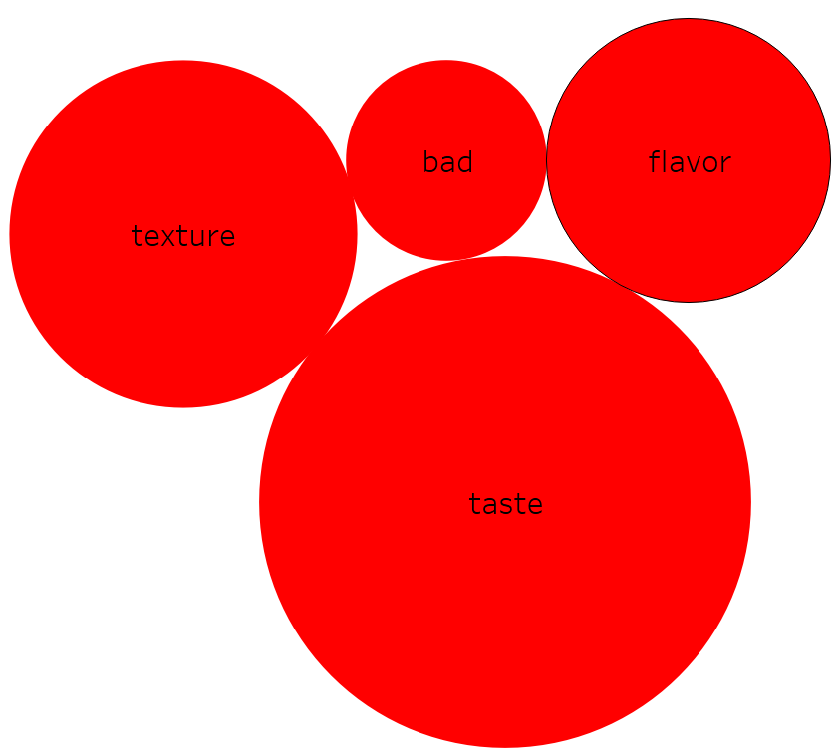
Fake Meat Brand Sentiment
Vegan, love, good, really, great, meat
bad
Notes:
Brand choices:

Slide 28
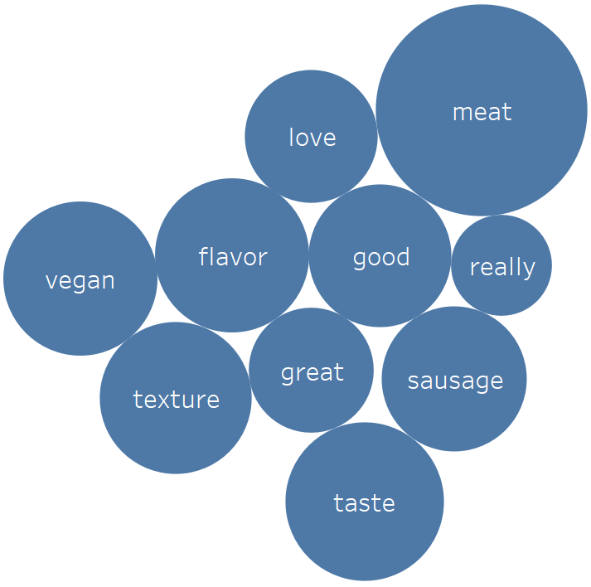
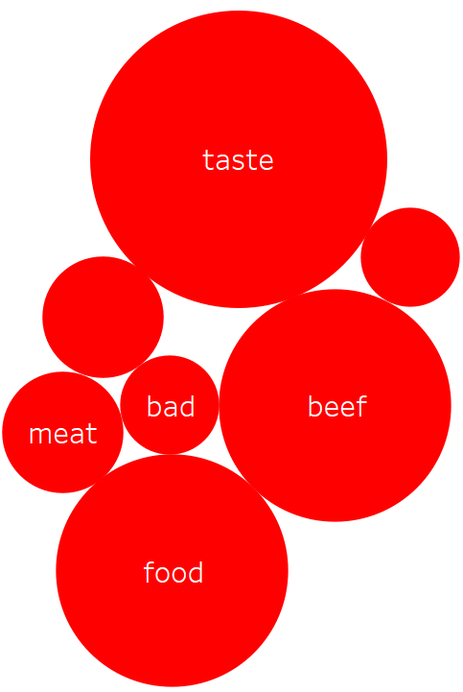
Fake Meat Brand Sentiment
Vegan, love, good, really, great, texture, sausage, flavor
bad
Notes:
Brand choices:

Slide 29
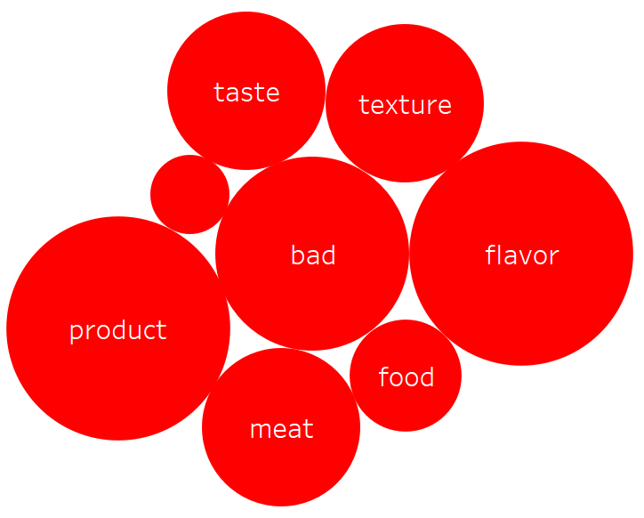
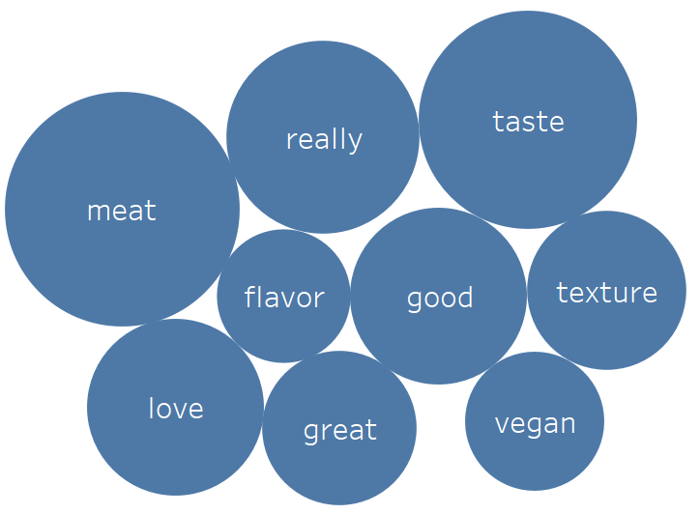
Fake Meat Brand Sentiment
Vegan, love, good, really, great
Bad, product, food
Notes:
Brand choices:

Slide 30
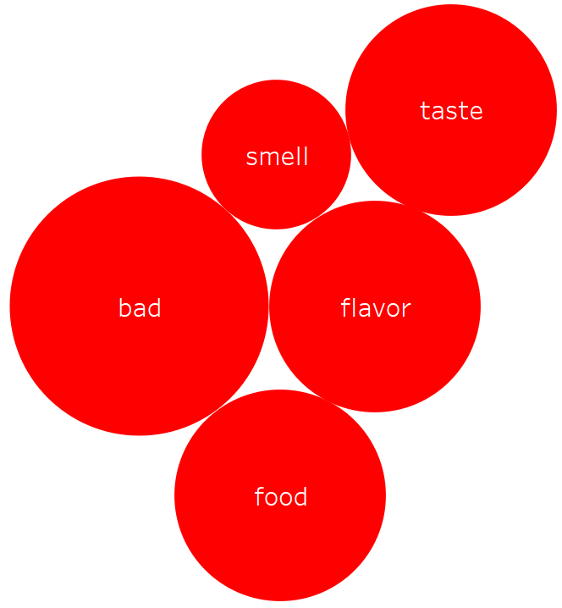
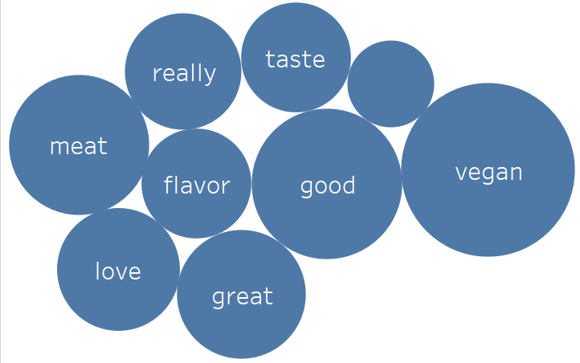
Fake Meat Brand Sentiment
Vegan, love, good, really, great, taste, meat
Bad, smell, food
Notes:
Brand choices:

Slide 31
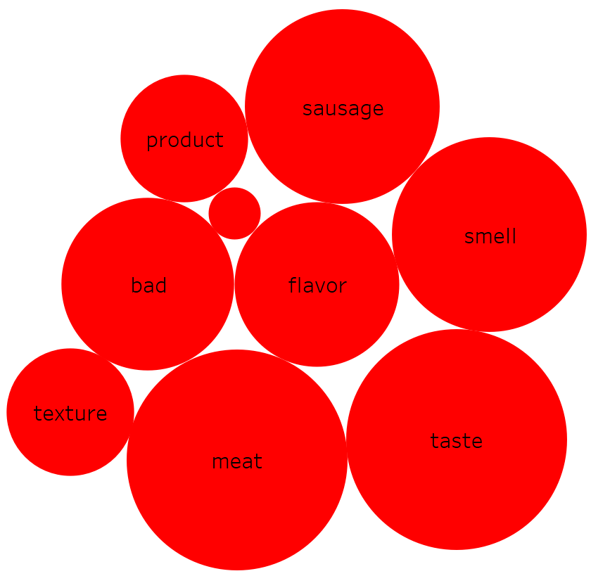
Fake Meat Brand Sentiment
bad
Product, bad, smell
Notes:
Two word clouds to show the 10 most frequent words used in positive (blue circles) and negative reviews (red circles). Stars indicate words that are only used in one sentiment review (positive or negative).
This view allows a store owner to associate keywords that define a brand with positive and negative reviews. By doing so, the store owner is afforded a comparison between positive and negative “traits” per brand (previous slide) or positive/negative traits for a brand comparison (this slide)
Starred words indicate words with high frequency in one brand and that do not show up in high frequency in a review of a product from a different brand.

Slide 32
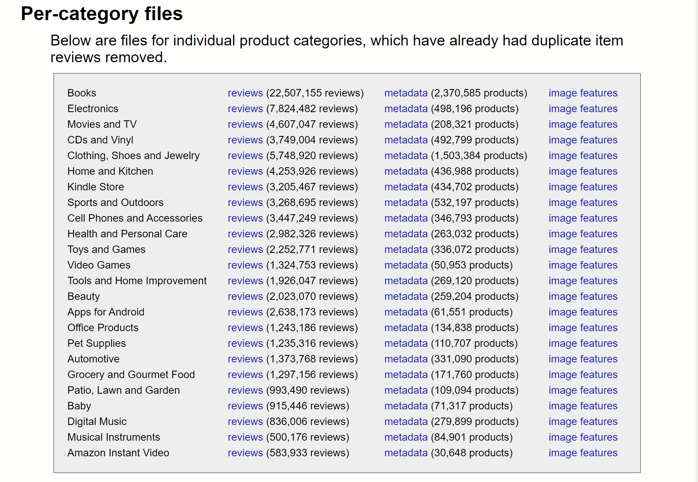
Exploration
Amazon product data
Reviews
*****/*
text
review length
Metadata
brand
product
price
Notes:
Our initial goal was to use amazon reviews to create a machine learning algorythm that accurately predicts whether a review is positive or negative.
In the reviews dataset the information provided was the rating 1 through 5 stars, the review text as well as other information such as date etc. We decided we wanted to know if there was a connection between the length of the review and the rating so I created another column that counted the number of words in each review with a lamda function. That was the review length column.
Our goal was to focus on fakemeat products but in the reviews dataset there was no brand and product information so we added the metadata dataset hoping that it would be easy to combine the two and find reviews specifically about fake meat.
That did not work well since from a dataset of more than 5 million reviews, the number of reviews about fakemeat was small. Then when we combined the metadata about fakemeat with the original reviews dataset, we were left with no data. We found out that it was due to the asin numbers not matching. After multiple attempts at merging joining, and concatinating the data with no significant success we decided to shift to scraping reviews with product and brand information.

Slide 33
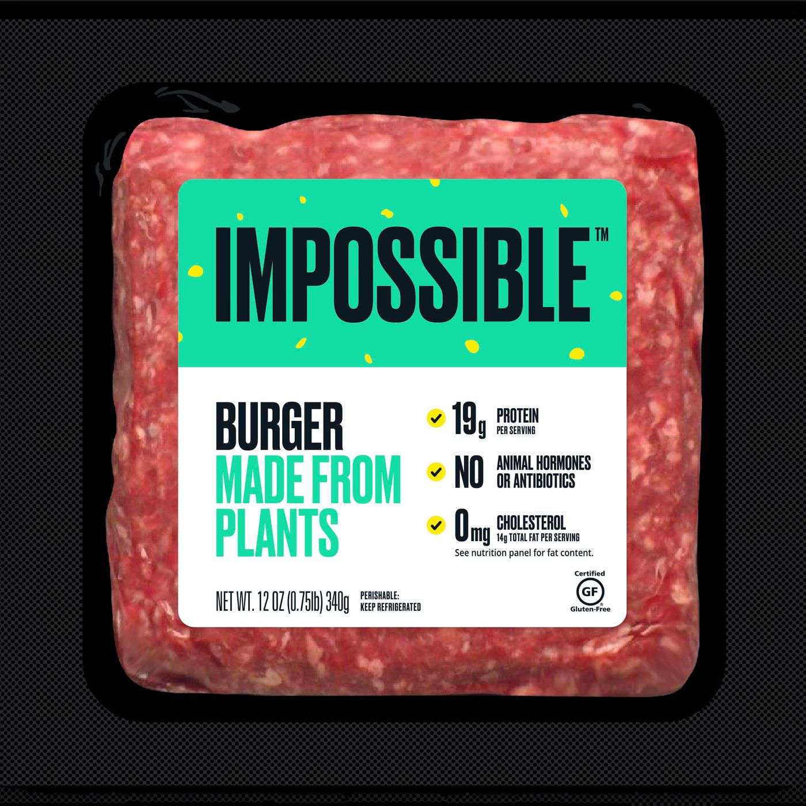
Exploration (cont’d)
Amazon product data (cont’d)
scraping
*****/*
text
brand
product
price
Notes:
We scraped data from amazon to add the brand product price information
We focused specifically on fake meat products.
We wanted to learn about impossible meat products but it was impossible because we focused on amazon and amazon do not have their products.
So we chose 5 other common fakemeat products.
Once our machine learning algorythm is trained with this data, we could take reddit reviews that do not have a star rating and use our algorithm to determine if the review is positive or negative. This way we do not rely on the amazon rating and can provide groceries store owners with more information about fakemeat products.

